Slide 1





وزارة الاتصالات وتكنولوجيا المعلومات
DIGITAL MARKETING PLAN
Presented by:
group 3

Slide 2

CONTENT
1 | Our team
2 | Our story
3 | Business model canvas
4 | SWOT Analysis
5 | Competitor Analysis
6 | SOSTAC Analysis
7 | Audience Segmentation
8 | Our Strategy
9 | Analysis
10 | upcoming

Slide 3

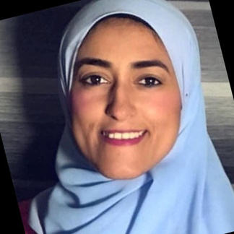
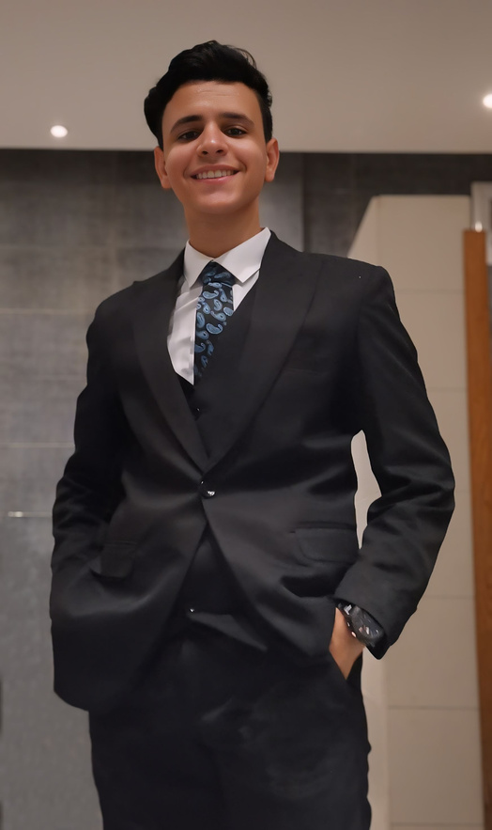
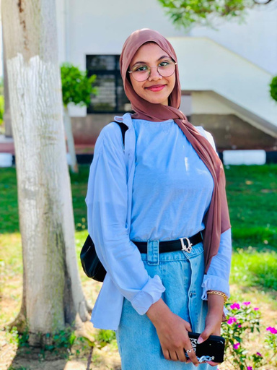
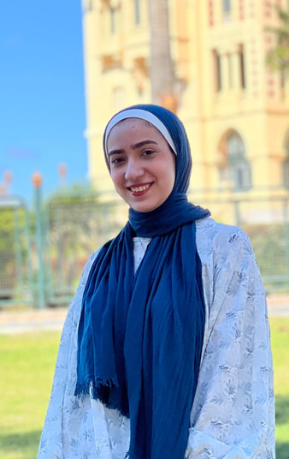
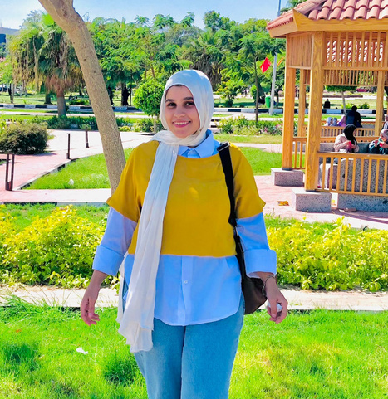
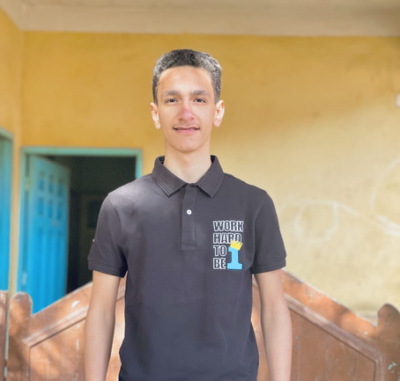
Supervisior
MARKETING TEAM
dr :sarah meklad
Kerolos Ata
Fatma Shazly
Menna Abd Elhady
Hager Mohamed
Ebrahim yasser
role :
role :
role :
role :
role :
business model canvas
sostac analysis
business strategy
website
SEO
final presentation
content calendar design
competitor analysis
final presentation
content calendar
and designs
swot and pest analysis
content calendar design
page moderation
photography & montage
content calendar designs
target personas
content calendar designs
ad campaign launch and analysis
ad campaign launch and analysis
ad campaign launch and analysis
ad campaign launch and analysis
ad campaign launch and analysis

Slide 4
our story
Welcome to SkateZone !
Our journey began with a simple yet powerful vision: to create a vibrant, inclusive space where skaters of all ages and skill levels can come together to learn, practice, and grow.
At SkateZone, we’re more than just a skatepark. We’re a family dedicated to fostering a love for skateboarding and building a supportive community. With African skateboarding champions leading our training sessions, we offer professional guidance in a safe, energetic environment. Our trainers are not only experts but also passionate mentors who strive to inspire every skater to reach their full potential.

Slide 5





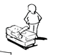



our Business Model Canvas
SkateZone
Key Partners
Key Activities
Value Propositions
Customer Relationships
Customer Segments
Collaboration with local sports clubs and schools or educational programs.
Event sponsorships with local sports equipment stores and youth-oriented businesses (e.g., clothing stores).
Training
organizing events
Marketing through different media channel
Professional training by African skateboarding champions
A family-oriented and community-building experience
Personalized training programs
Organizing community events and competitions
Offering loyalty programs or discounts
Families looking for safe community-oriented sports activities for their kids
young adults who want to learn skate
young adults who are looking for place to practice skate and have fun
Key Resources
Channels
Skilled trainers (African champions)
A physical location (skate park or facility)
Marketing and promotional tools (social media, website)
Social Media
Word of Mouth and Local Community Events
Website with Booking Features
Cost Structure
Competitors
Revenue Streams
Rent,
staff salaries
marketing through ads
Operational costs
suez skate academy
street skate academy
skate master academy
Membership fees
per session fees.

Slide 6

time for market research

Slide 7


S
W
We are aware that our success story begins with knowing who we are and where we stand, so we will start with a self-analysis
O
T

Slide 8






STRENGTH
Specialized trainers for beginners, offering medical and health advice during exercise.
Private training environment for girls with a female coach.
Specialized coach available for injury cases.

Slide 9




WEAKNESS
Limited financial resources at the moment, which reduces the potential for expansion.
The academy is currently limited to attracting people only from nearby areas, which restricts its growth potential.
weak online presence
weak engagement with the audience
no website unlike competitor

Slide 10



OPPORTUNITY
Increased interest in skateboarding as a sport can drive enrollment.
Utilizing social media platforms for marketing campaigns to attract younger audiences and promote programs.
The academy can consider opening branches in other cities to increase its student base.

Slide 11



THREATS
A reduction in disposable family income may affect spending on non-essential recreational activities like skateboarding
Fear of injury may deter potential learners, limiting the brand’s customer base

Slide 12




Compititor Analysis
Channel: Facebook
Strategy
Strength
Weakness
Notes
We post 9 times per month
Unspecified tone of voice
Branding content
Channels: Facebook, Instagram
Private training environment for girls with a female coach.
Specialized coach available for injury cases.
We don't post content regularly.
lack consistency in our content posting
We don't publish engagement content
We are facing a decline in our academy's page engagement and a lack of interaction due to the discontinuation of new content uploads over the past two years.
skatezone
Write here
They post16 time per month.
They using Branding content.
Formal tone of voice
Channels: facebook, instagram, Youtube, strong website.
They post regularly. participate in international competitions.
They have a branch in Cairo. provide high-quality content.
They using English instead of Arabic.
not consistent designs.
They should pay more attention to unified designs, increasing use of Arabic language, and do more educational and interactive content.
Suez skate
They publish content 8 times per month.
They using engagement content
Channels: facebook, instagram, website, tiktok
Encouraging tone
They use Engaging writing style.
They have consistent designs.
They organize interactive competitions.
They need to focus on their academy's Facebook page. Instead of coach personal page.
Their trainees won medals in various competitions.
street skate
skate master
They post 10 times per month
They using branding content
Unspecified tone of voice
Channels: facebook, insagram
High quality videos
They organize interactive events.
Weak strategy
The content is full of filler words
The writing could be more streamlined
Use consistent designs

Slide 13

conclusion
#1 We have a weak design consistency
#2 Weak audience engagement
#3 Competitors have a better reach
#4 One competitor has a website
#5 Competitors post regularly

Slide 14






SOSTAC :skatezone
Tracking: Use social media metrics such as followers, likes, shares, and comments to gauge performance.
Review Frequency: Weekly reviews to ensure that the strategy is on track and adjust tactics as needed.
Key Performance Indicators (KPIs): Monitor follower growth (target: 20-30%), website traffic increases
(target: 10%), and conversion rates (target: 5%).
Digital Presence: SkateZone currently has Instagram, Facebook, and a plans for website with plans for a booking system.
Customer Engagement: Social media engagement is weak with some consistency but room for growth.
Brand Awareness: There is small local awareness in the Suez community, with potential for expansion.
Situation
Analysis
S
Control
Objectives
Content Production: Manage content creation in-house, using current tools and available resources to produce engaging social media content.
Execution of Ads: Run social media ads targeting the local community, beginners, and families, using geographic and demographic targeting.
Timeline: Launch new content and ads within a defined 3-month period, starting with weekly updates and reviews.
C
O
Brand Awareness: The goal is to increase brand recognition within Suez by using digital channels, specifically aiming for a 20-30% increase in social media followers within 3 months.
Website Traffic & Conversion: Grow website traffic by 10% and achieve a 5% conversion rate (bookings).
Social Media Engagement: Increase engagement on platforms such as Instagram and Facebook.
.
A
S
Content Creation: Focus on short-form videos (Instagram Reels, TikTok) showcasing training sessions, tricks, and behind-the-scenes footage.
Paid Media: Invest in Facebook and Instagram Ads to drive awareness, leveraging targeted ads to attract beginners and local families.
SEO: Incorporate local keywords like "skate in Egypt" and "learn skate" for organic search visibility.
Community Engagement: Run polls, contests, and giveaways to increase engagement and community involvement.
Actions
Strategy
T
Focus: Prioritize social media marketing through engaging content and paid advertising to enhance visibility.
Target Audience: Focus on beginners looking to learn skateboarding, a growing segment, while also keeping families and local youth organizations in mind.
Positioning: Emphasize SkateZone’s unique value proposition—professional training from African champions and a community-centered environment.
.
Tactics

Slide 15

our audience segmentation

Slide 16

Psychographic Information
Goals/Aspirations
Behavioral Information
Looking for a skate academy that has specialized trainers To register her son Yassin
Enabling Yassin to make new friends through the academy, which enhances his social skills and self-confidence
Sarah tends to search through social media and read reviews to find out the advantages and disadvantages of the activities she is considering enrolling Yassin in. Seek information before making a decision.
She personally visits the academy before enrolling to make sure the place is safe and organized, and will ask to meet the coaches to get to know them and make sure they are able to deal with the children.
Challenges/Pain Points
Sarah Ali
Extreme fear of injury and her desire to know if the academy would provide all means of safety
She is busy all the time between her work and Yassin’s studies, and if the academy is unable to provide a suitable schedule for them, they will not be able to register.
Background & Demographics
Age:28
Location:Cairo, Egypt
Gender:female
Education:Bachelor's degree holder
Profession:Employee in a technology company
Marital Status:Married with one child
Income8000:
Childern:1
Motivations & Influences
Motivations:
One of Sarah's most important motivations is to help Yassin gain self-confidence and gain new friends through the academy
She wants to make sure the academy has safe areas for skeet and all the medical supplies in case Yassin is injured
Effects
Academy programs that offer flexible options that fit Sarah's schedule and reduce stress on her daily life greatly influenced her decision.
Academies that have a good reputation and care about safety and organization are an influencing factor in Sarah’s decision, as she is looking for reliable institutions.
Personality Traits
One of her personal characteristics is that she loves providing a comfortable educational and sports environment that helps Yassin grow and develop
Values & Beliefs
She think that playing singles is not the best solution for Yassin, but rather he should enter an academy to learn with a specialized coach and meet new friends.
Lifestyle
Her favorite hobby is searching for the best places for her son to learn the game he loves
Information about the child:
Name: Yassin
Age: 7 years

Slide 17
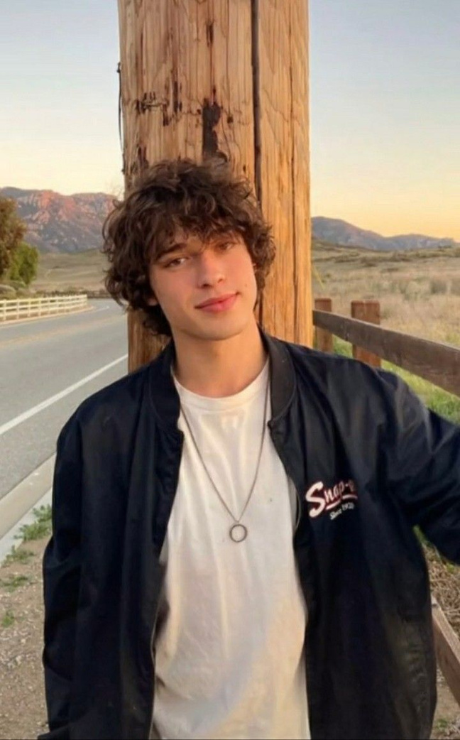
Psychographic Information
Goals/Aspirations
Behavioral Information
Omar aims to join a skate academy that includes professional trainers and has many activities and events. One of his goals is to join an academy that will help him enter local skating tournaments and participate in competitions and challenges.
Omar is social by nature and loves interacting with others while skating. Skating is a way to increase his connection with his friends and build new friendships within the skating group
Omar has a strong competitive sense and always loves improving his skating skills. He follows a strict training regime and constantly monitors his personal performance
Challenges/Pain Points
He don't want to join an academy with limited spaces dedicated to skating.
Difficulty balancing daily work and skate training
Omar Mohamed
Effects:
He is influenced by the surrounding community of skating professionals and celebrities in this field.
He follows training videos and international skating competitions.
Motivations:
He continues his quest to win competitive competitions and be among the strongest professionals in the sport
Passion for becoming a role model for new skaters
Background & Demographics
Motivations & Influences
Age: 21 years old
Occupation: Works in a skate shop
Location: Cairo
Skate level: advanced
Personality Traits
Omar has a highly competitive sense and always strives to improve. He is social and loves interacting with the skating group
Values & Beliefs
He believes that they should continue in the sport until they reach their goals
Lifestyle
One of his favorite hobbies is going out and skating in public places and interacting with people

Slide 18
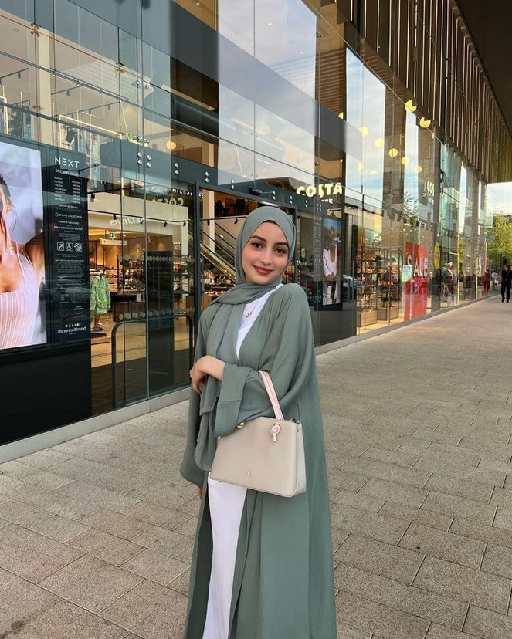
Psychographic Information
Goals/Aspirations
Behavioral Information
She wants to master the basics of skating and learn stunts like jumps and spins
She wants to join a skating academy that has separate training for girls.
She loves to meet and make new friends with girls who have the same hobby as skateboarding.
She uses social media to connect with her friends and follow professional skateboarders, which enhances her passion for skating and allows her to express herself in a comfortable way.
Nada Adel
Challenges/Pain Points
Girls' lack of interest in sports makes them feel isolated and in need of a role model or coach for girls.
She is afraid of falling or getting seriously injured, so she wants to practice in safe places since she is still a beginner.
Background & Demographics
Age: 18
Location: Suez
Gender: Female
Education :high school student
Profession :Not working
Marital Status : She lives with her parents.
Her level in sketch: Beginner
Motivations & Influences
Motivations:
•Nada seeks to join the sports community that shares her passion. Feeling part of a group of skaters makes her feel supported.
•Desire to improve oneself and learn more skills from experienced people
Effects:
•Watching videos of skaters on the academy’s page as they learn new skills makes them motivated to learn these skills.
•The academic environment can also influence her desire to participate. If the academy encourages collaboration and interaction, this enhances Nada's experience.
Personality Traits
She is shy and does not feel comfortable in mixed places where the number of girls is less than the number of men, so she prefers separate places.
Values & Beliefs
One of Nada's beliefs is that she should learn in safe places and play carefully to avoid risks and injuries
Lifestyle
Skateboarding is Nada's main hobby, where she enjoys trying new moves and improving her performance.

Slide 19
based on self-analysis and competitor analysis (their strengths and weaknesses) and also our current situation and our target audience we developed a whole strategy about what we will work on

Slide 20

1-imbrove brand viisibility
and engagement
the main goals in our strategy will be :
our goals
2- Increase Brand Awareness
3- increase Revenue Streams

Slide 21
SkateZone business strategy
goals
Increase Brand Awareness
increase Revenue Streams
improve Brand visibility and Community Engagement
objectives
Increase engagement rate on social media posts by 15% for this month
Increase the number of training sessions booked by 5% this month
Increase revenue by 15% in three months through targeted Meta messaging campaigns
Improve brand visibility
Increase social media reach by 20-30% within 1 months
establish a website in the next month
strategy
Optimize visual elements (logos, covers)
Create interactive and shareable content.
create and Optimize website for search engines (SEO)
Implement targeted social media marketing campaigns
Develop targeted marketing campaigns for training programs
Implement targeted messaging campaigns to promote services, discounts, and upcoming events to potential and existing customers
action plan
design Logo
Consistency Across Platforms and posts
Create Compelling Messaging
Create eye-catching visuals
Launch and Monitor Campaign
Engage with Respondents
Use polls on social media platforms.s.
Engage with followers through comments .
create skateZone website using wix
Conduct keyword research and incorporate relevant keywords into website content.
Create regular engaging content (videos, tutorials)(content calender ).
Run Facebook and Instagram ads focusing on local audiences.
Create promotional offers for first-time customers.
Utilize testimonials and success stories from current students in marketing materials.
Offer group discounts to attract families.

Slide 22






Explain how the following channels will help reach the campaign's target audience.
Marketing Channels
01
02
03
facebook
Instagram
bsite
website

Slide 23

to achieve our strategy we will go through our action plans step by step using our content strategy (content calendar) and screenshots

Slide 24
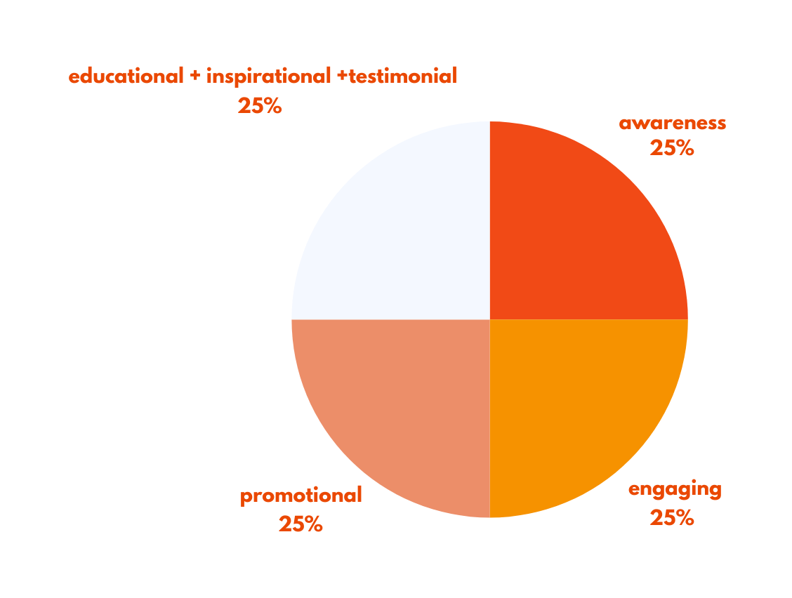
our content strategy
13 post per month
channels
facebook
Instagram
content
awareness content (25%)
2-engaging content (25%)
3-promotional content (25%)
4-educational + inspirational + testimonial (25%)

Slide 25
SOCIAL MEDIA
A 31-Day Content Plan for skate zone
CONTENT PLAN
MONTH:
OCTOBER
WEEK 1
01
02
03
04
05
06
07
awareness video (AD)
WEEK 2
08
09
10
11
12
13
14
awareness video
Educational post
inspirational
WEEK 3
15
16
17
18
19
20
21
Engaging post
Promotioal
awareness post
WEEK 4
22
23
24
25
26
27
28
Promotioal
Engaging
Engaging
WEEK 5
29
30
31
Testimonial post
promotional

Slide 26

details
goals
improve Brand visibility and Community Engagement
objectives
Increase engagement rate on social media posts by 15%.
Improve brand visibility
strategy
Optimize visual elements (logos, covers)
Create interactive and shareable content.
action plan
design Logo
Consistency Across Platforms and posts
Use polls on social media platforms.s.
Engage with followers through comments .

Slide 27
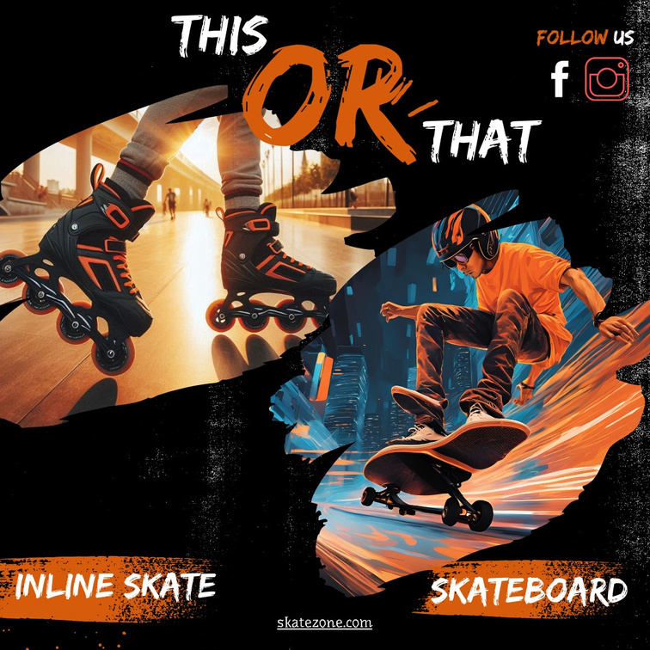
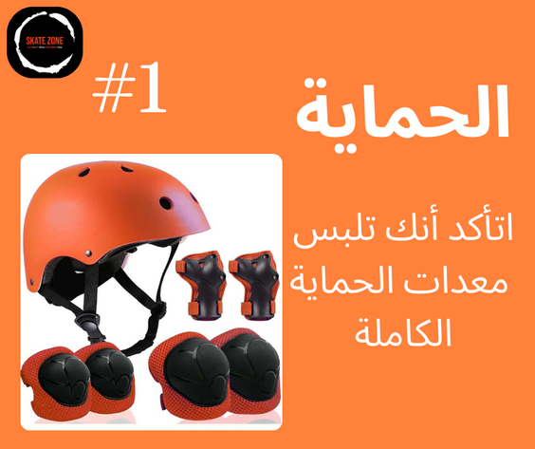

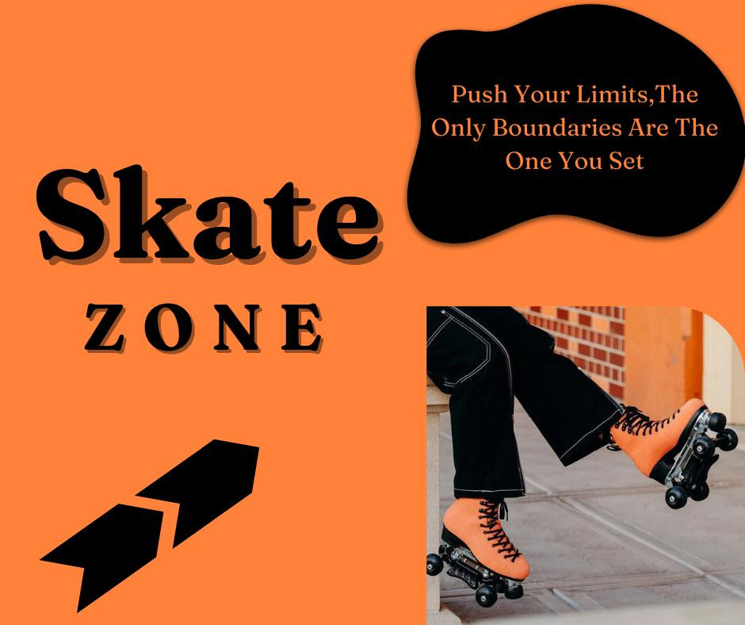
attractive logo design
Consistency Across Platforms and posts

Slide 28


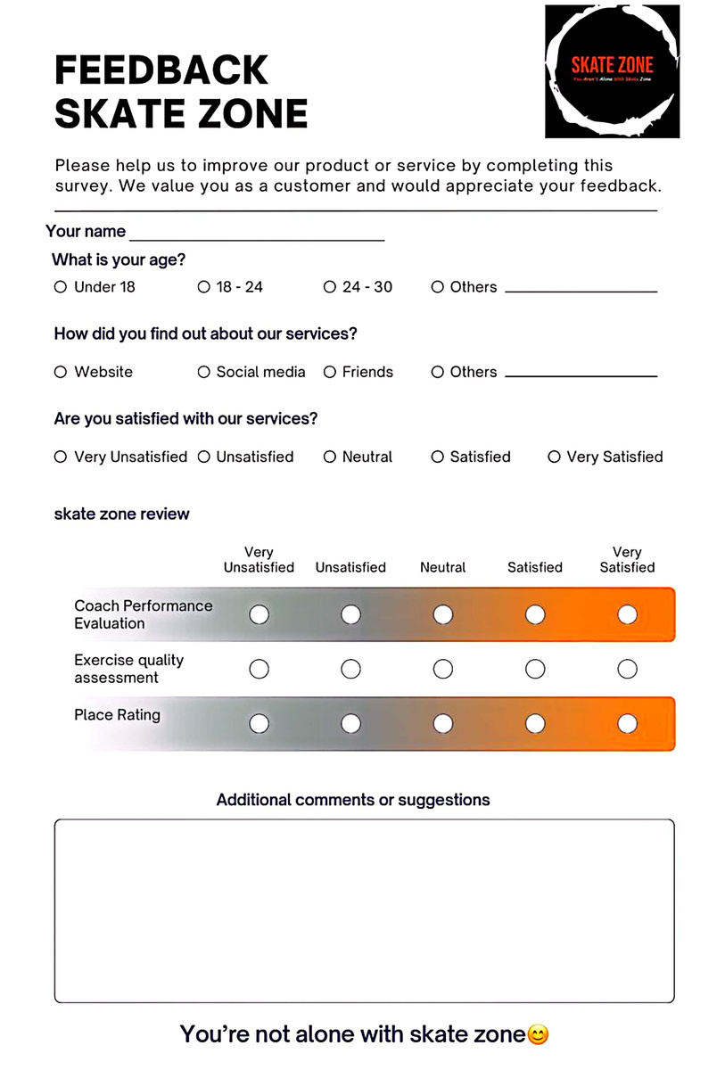
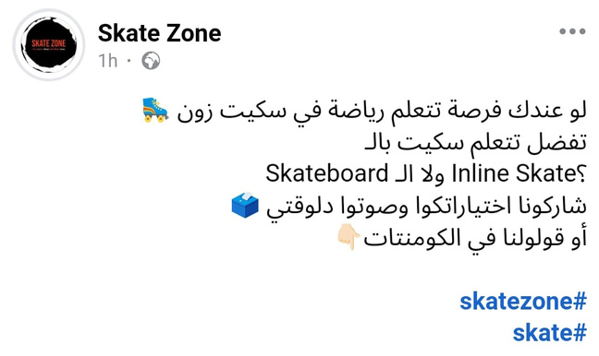
ENGAGING POST
engaging with audience
and on-ground poll to get feedback and testimonials

Slide 29
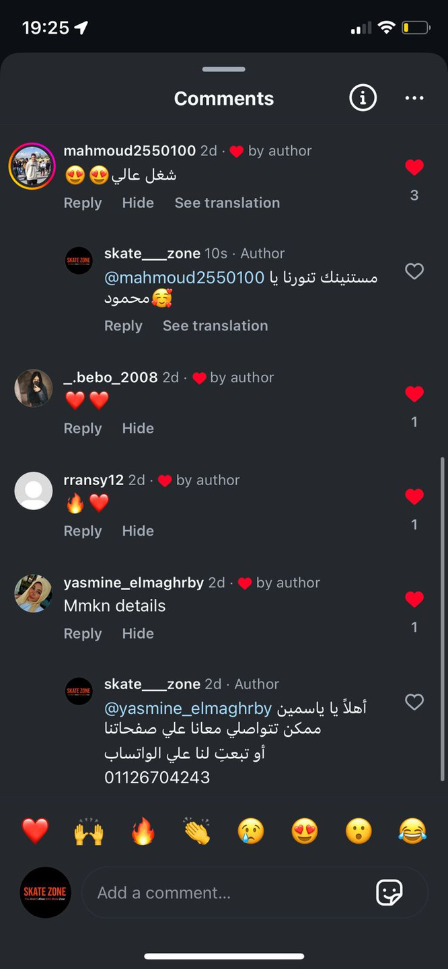
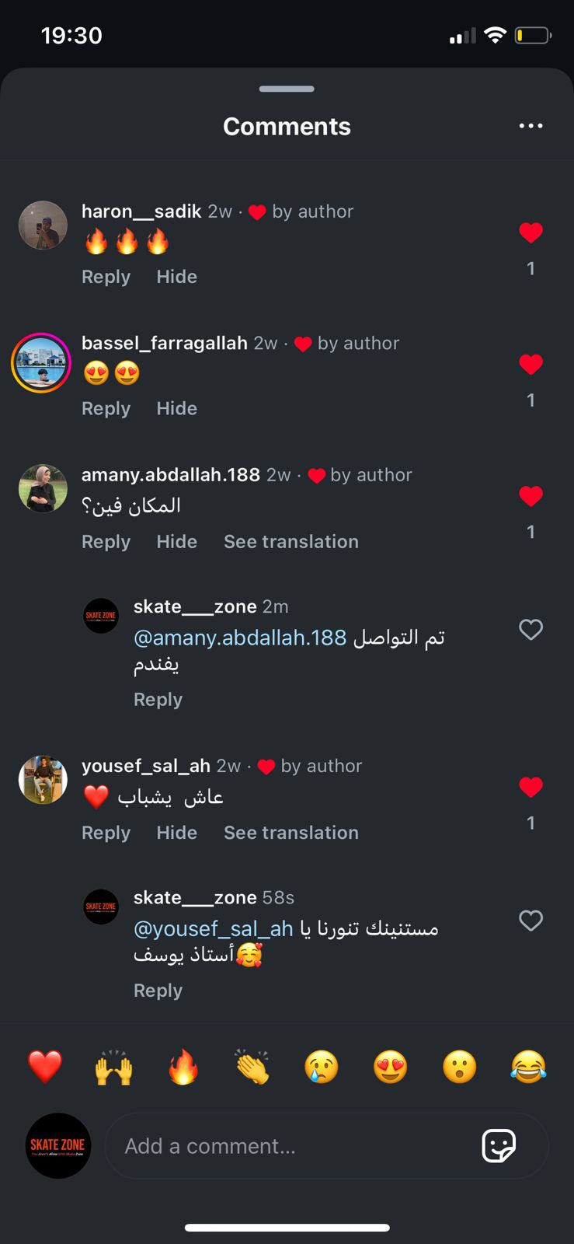
ENGAGE WITH FOLLOWERS THROUGH COMMENTS

Slide 30
details
goals
Increase Brand Awareness
objectives
establish a website in the next month
Increase social media reach by 20-30% within 1 months
strategy
create and Optimize website for search engines (SEO)
Implement targeted social media marketing campaigns
action plan
create skateZone website using wix
Conduct keyword research and incorporate relevant keywords into website content.
Create regular engaging content (videos, tutorials)(content calender ).
Run Facebook and Instagram ads focusing on local audiences.

Slide 31

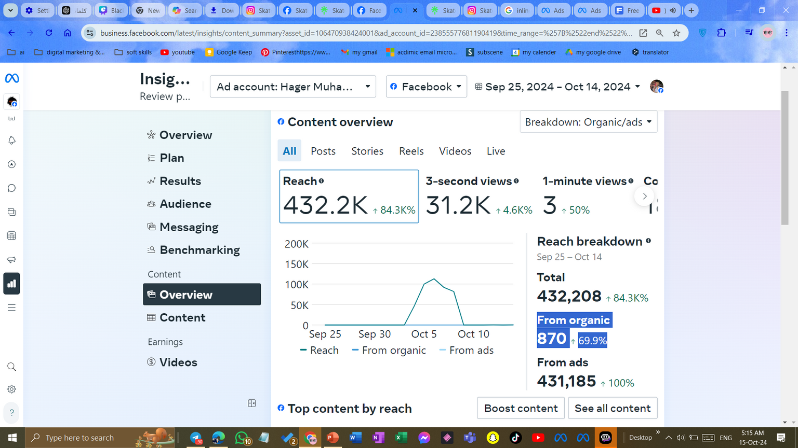
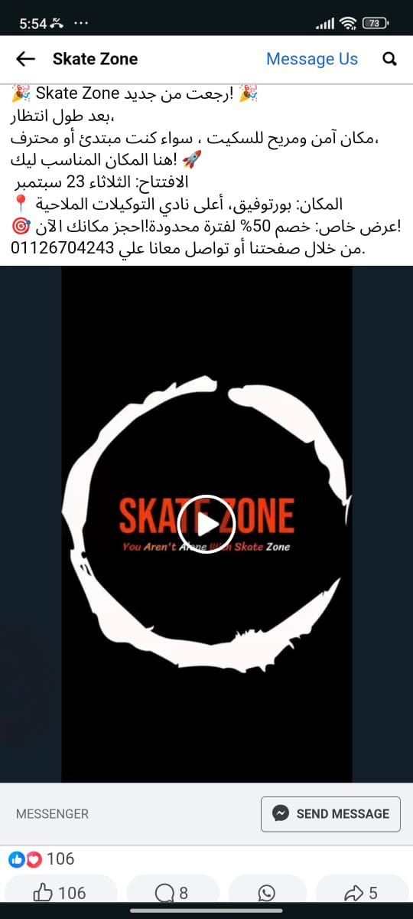

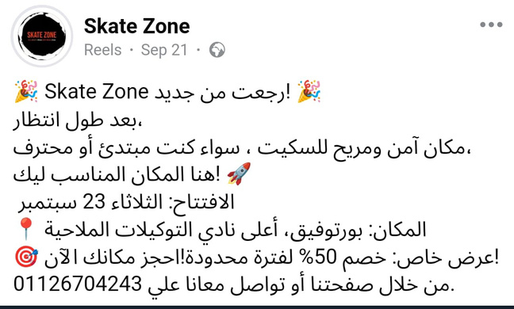
AWARENESS VIDEO
PAID AD
CAPTION
CLICK HERE

Slide 32

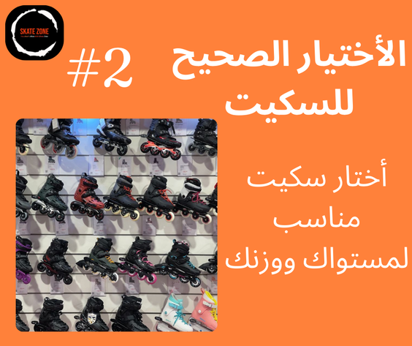
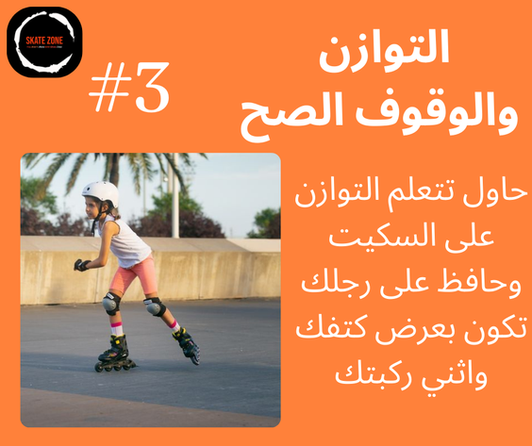
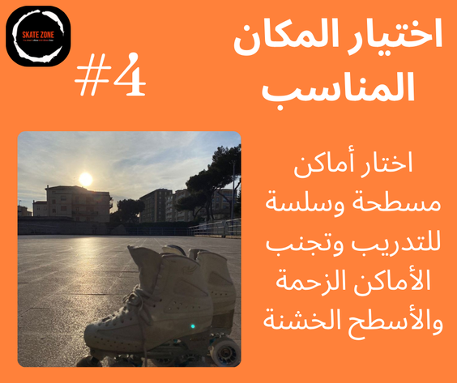
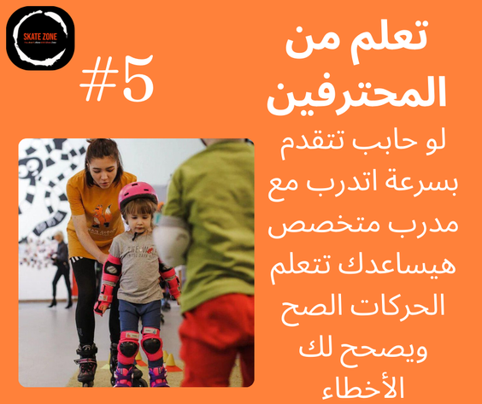
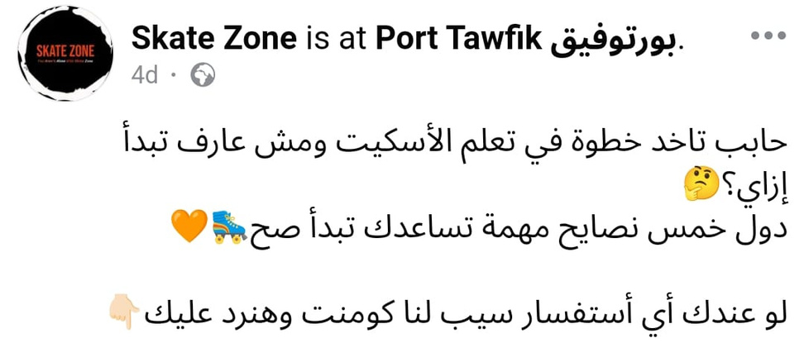
EDUCATIONAL POST
CAPTION

Slide 33
website and seo

Slide 34




Keywords to Target
keyword
source
1 keyword planner
1 skate
2 skate in Egypt
2 strong competitor
3 skate for kids
2 search suggestion
2 search suggestion
4 beginner skate

Slide 35
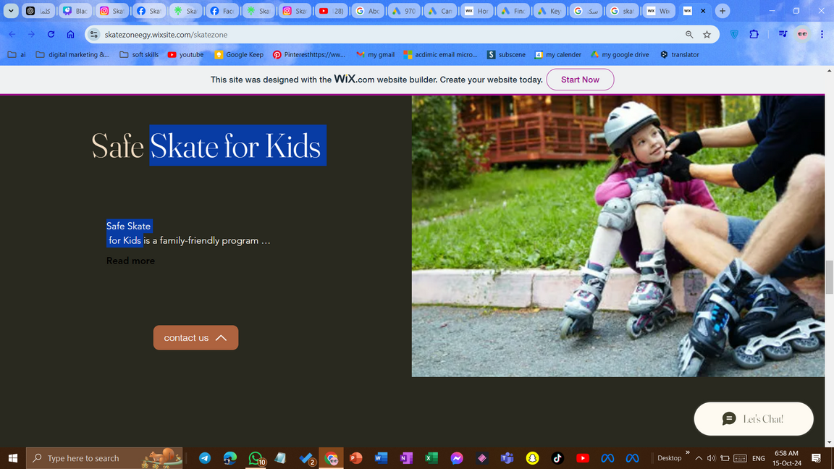
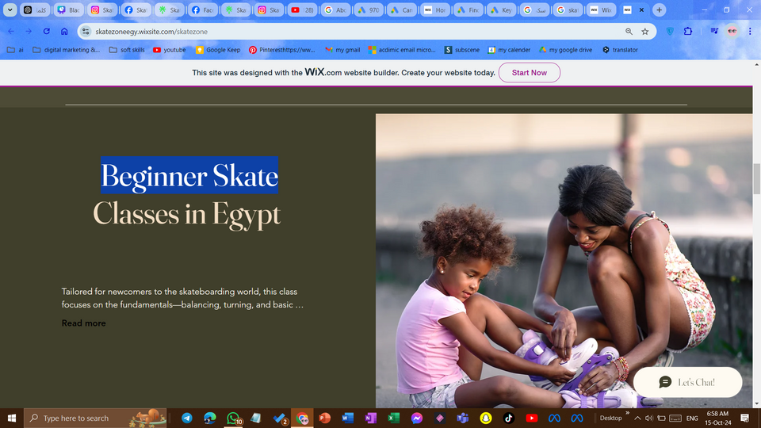
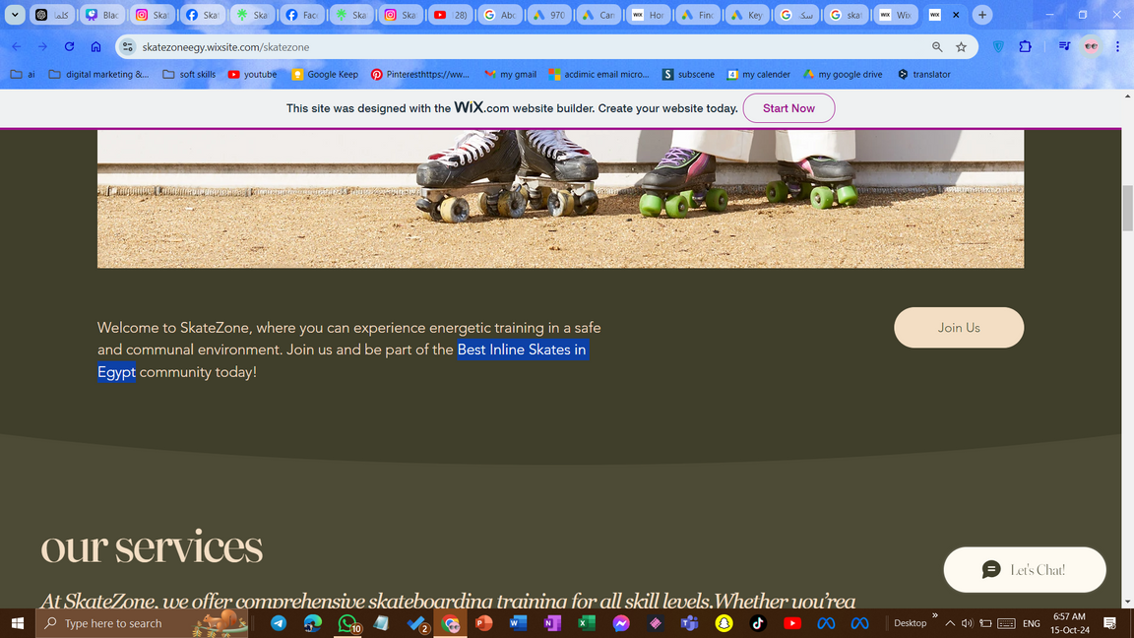
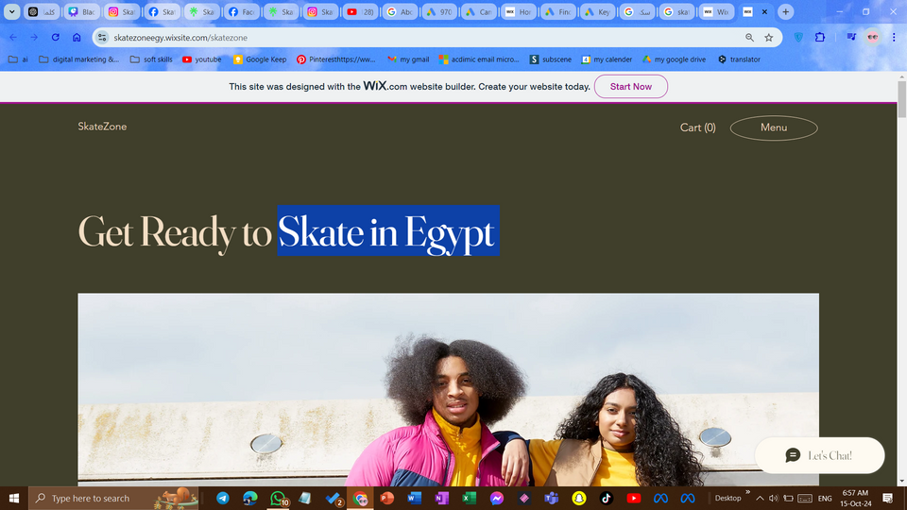

Slide 36
details
goals
increase Revenue Streams
objectives
Increase the number of training sessions booked by 5% during this month
Increase revenue by 15% in three months through targeted Meta messaging campaigns
strategy
Develop targeted marketing campaigns for training programs
Implement targeted messaging campaigns to promote services, discounts, and upcoming events to potential and existing customers
action plan
Create promotional offers for first-time customers.
Utilize testimonials and success stories from current students in marketing materials.
Offer group discounts to attract families.
Create Compelling Messaging
Create eye-catching visuals
Launch and Monitor Campaign
Engage with Respondents

Slide 37
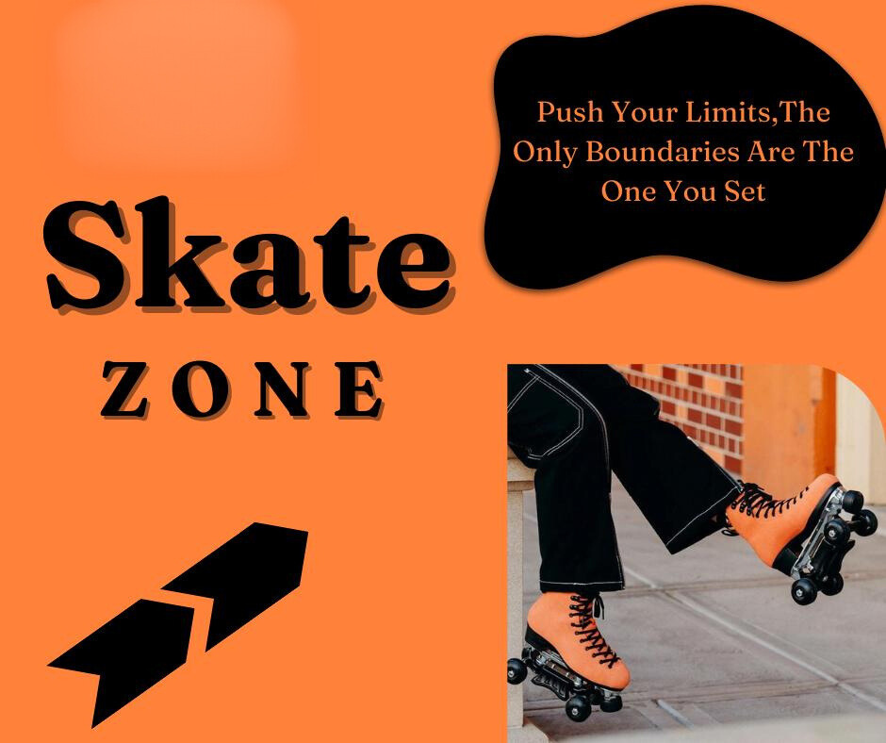

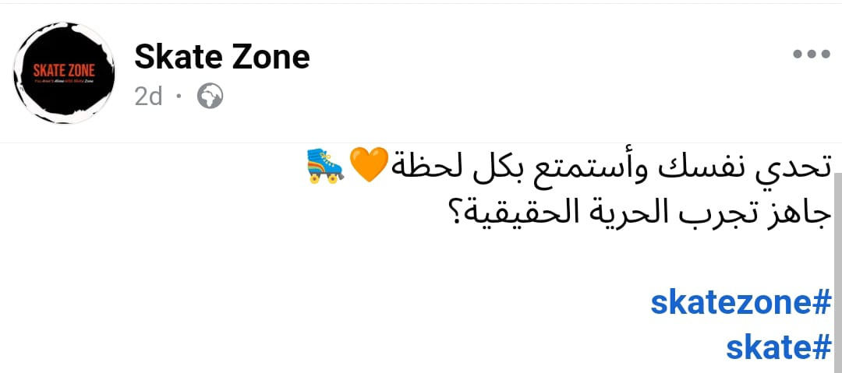
PROMOTIONAL POST
50%
off
CAPTION

Slide 38

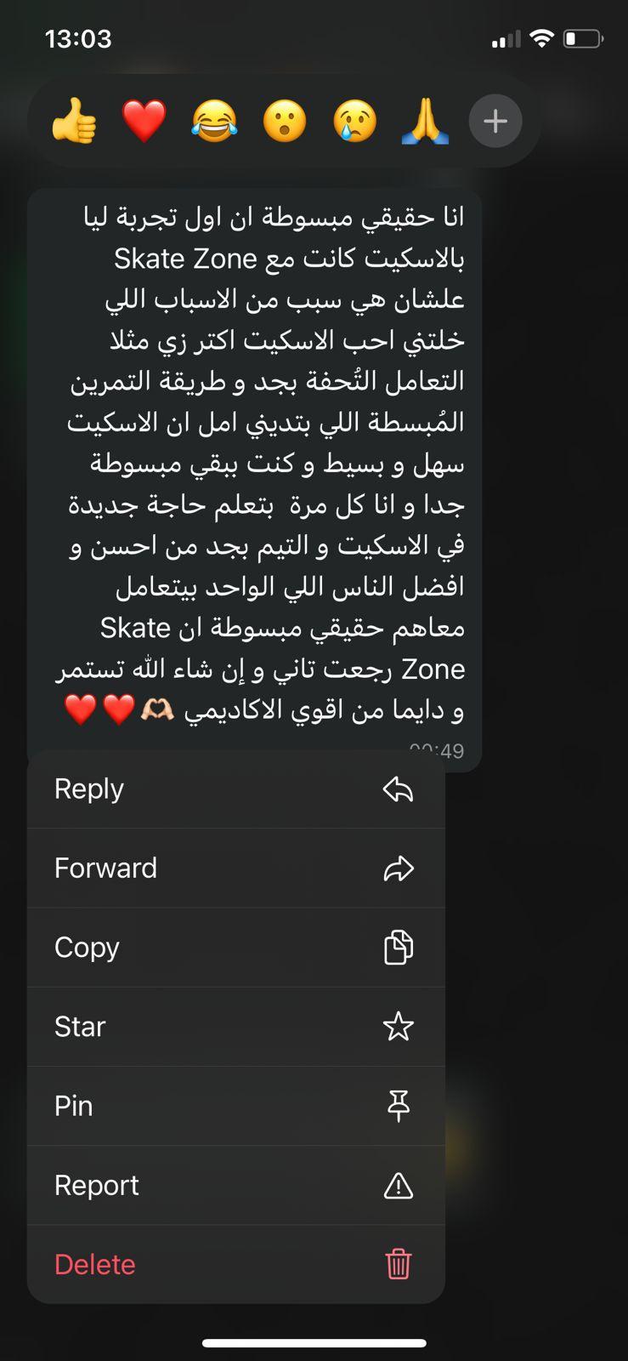
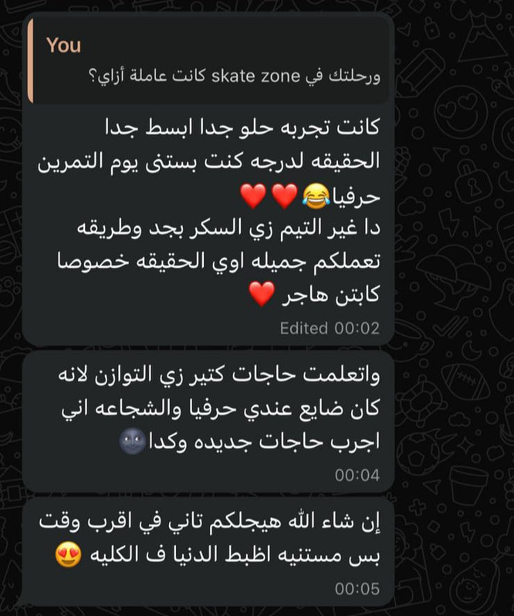

TESTMONIALS
CAPTION
ليه تختار SKATEZONE ؟

Slide 39


promotional designs for upcoming content

Slide 40
time for analysis, results, and upcoming steps

Slide 41

analysis
goals
results
increase brand awareness by 20-30 %
69.9% increase in organic reach
84.3 % increase in paid reach

Slide 42
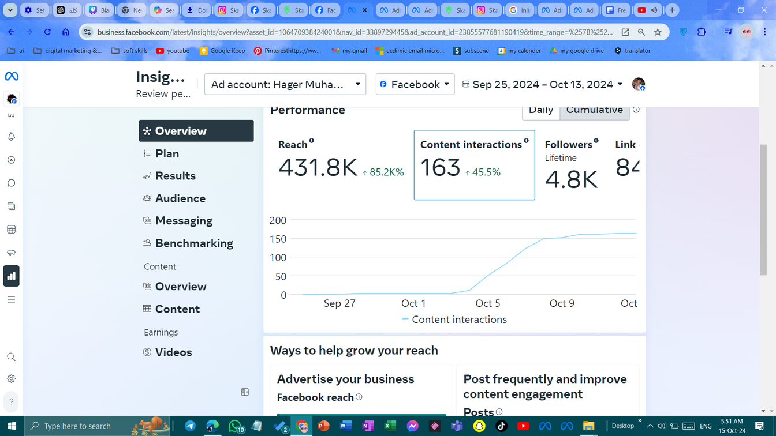
analysis
goals
results
increase brand visibility and engagement by 15%
45.5 % increase in content interactions

Slide 43
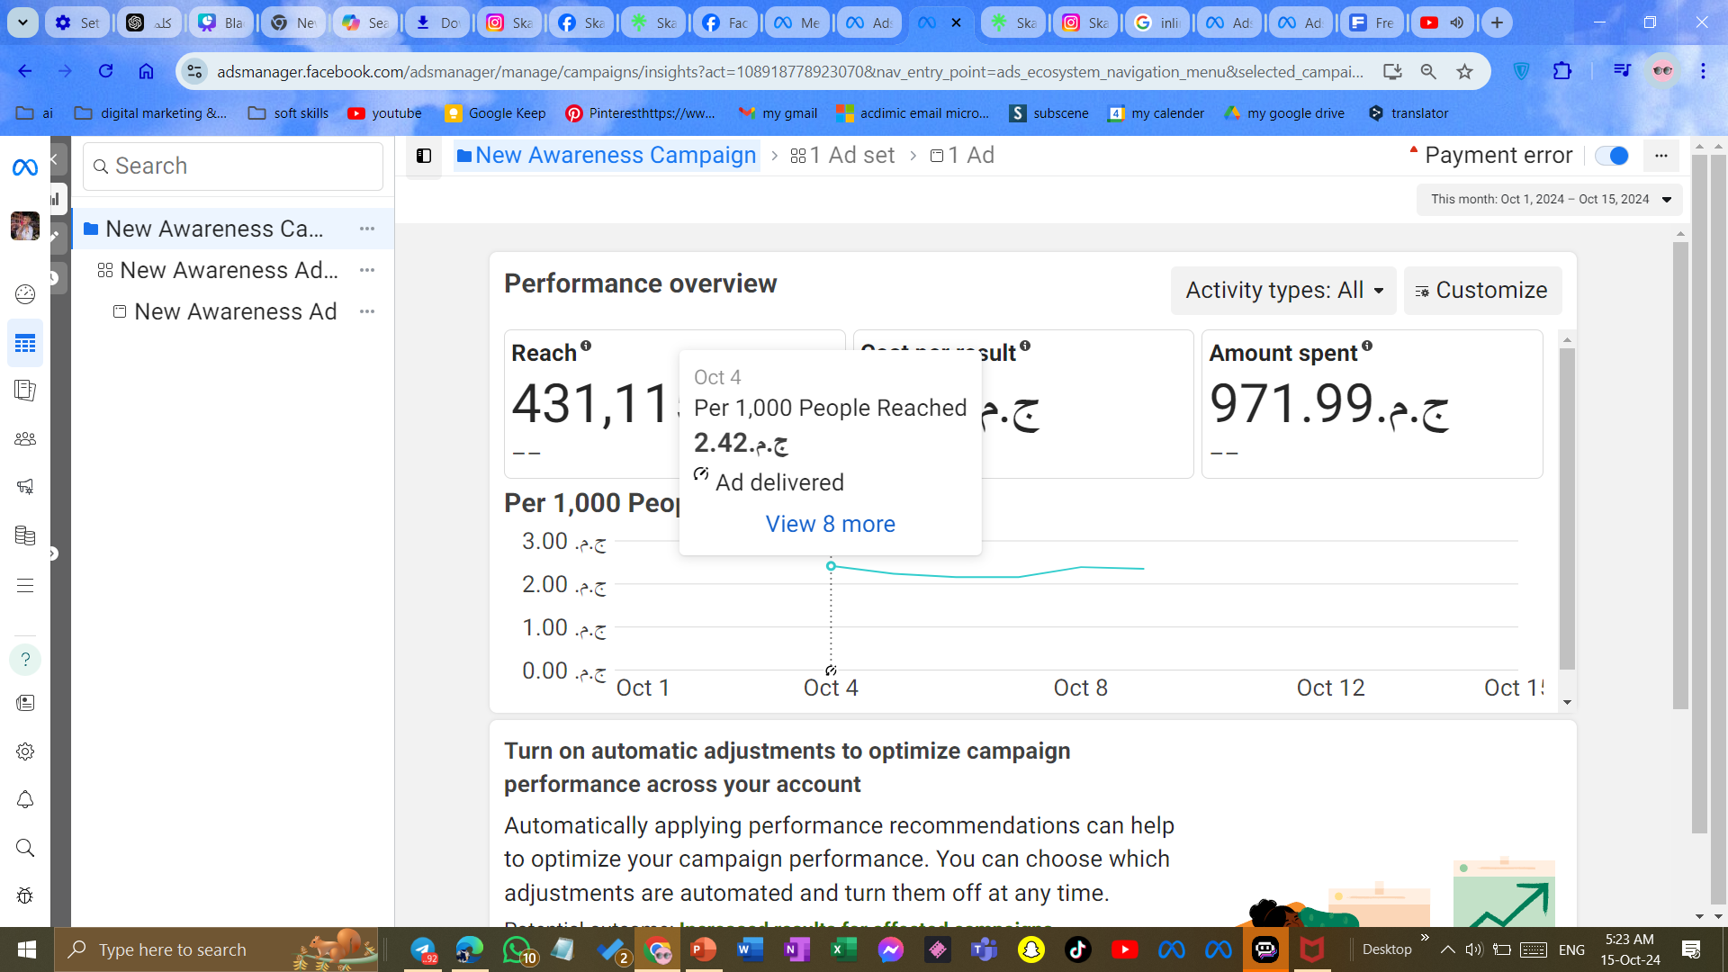
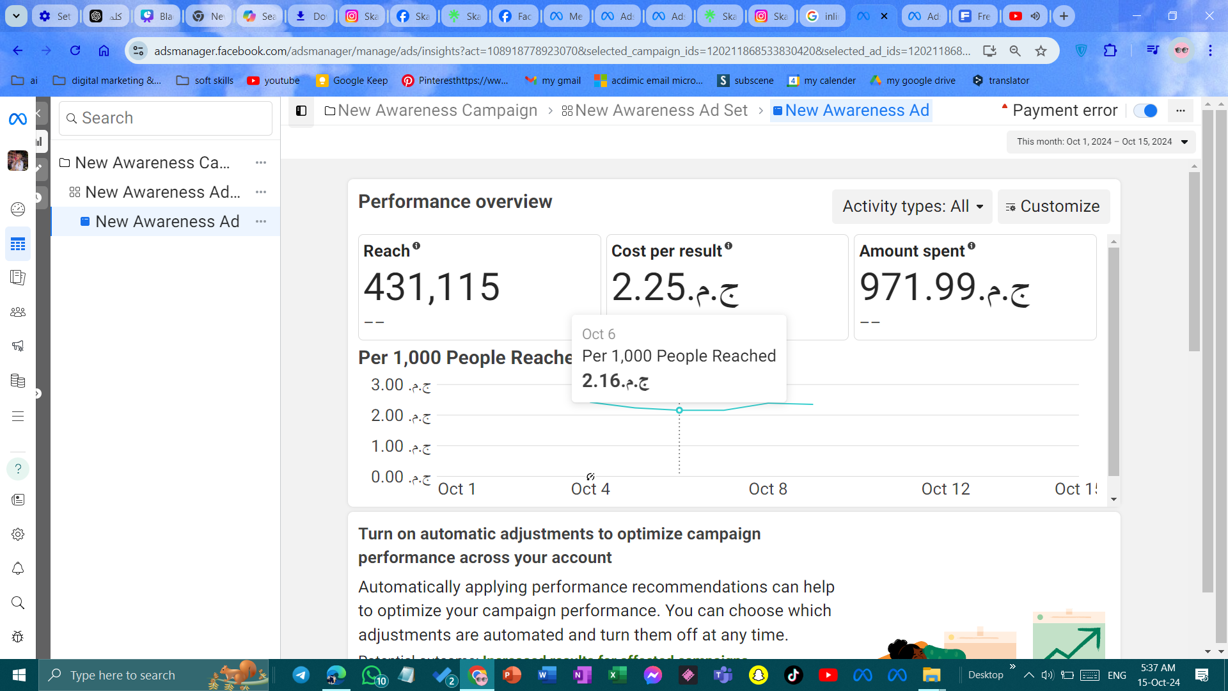
analysis
results
goals
launching and active management of ad campaign
reduced CPR after reduce the specificity of targeting

Slide 44

UPCOMING (التوصيات والتحسينات)
more focus on reels
messaging campaign
more optimization and work on the website and use of Google Analytics more
focus on increasing numbers of followers
planing for influencer marketing
make our content more emotionally
use testimonials and success stories in 0ur content
collect email database and launch a mail campaign

Slide 45



OUR CONTACTS
Phone number
Email
+20 11 26704243
szskatezone@gmail.com
Website
Social networks
https://skatezoneegy.wixsite.com/skatezone
https://linktr.ee/skate_zone?utm_source=linktree_profile_share<sid=5cd39974-94ff-4579-ab20-0e320ffe893e

Slide 46




WE WANT TO SAY
THANK YOU!
FOR COMING

